Slide 1
NAVISH NAGPAL & COMPANY
Chartered Accountants
Firm Profile

Slide 2
About US
Navish Nagpal & Company (NNnC) is a Chartered Accountant Partnership Firm registered with :-
The Institute of Chartered Accountants of India (ICAI)
Reserve Bank of India (RBI)
Comptroller and Auditor General of India (CAG)
We have been offering multitude of services in
Audit & Assurance
Consultancy & Management
Due Diligence Reviews
Virtual CFO & Other Finance Outsource Services
Tax Planning & Tax Management
ROC Compliances & Miscellaneous Company Matters
under one roof since 29 years. The firm is having a team of 45 members including Certified Chartered Accountants , Subject matter experts, qualified executives and articles who assist to provide the best & satisfactory services all the times. We are ISO 9001:2015 certified company.
We have been serving clients from across various businesses and believe in providing comprehensive solutions to assist our clients in meeting the challenges of a dynamic business environment.

Slide 3
Mission Vision Values
Mission : Exceeding the expectation of our clients by consistently rendering quality services and becoming one of the top consulting firms in India.
Vision : To be the most reputed, independent Chartered Accountants firm delivering quality services to our clients while providing a work environment where our firm members evolve professionally and can be responsible members of our community.
Values : We work as a team and share knowledge for continuous improvement, learning and innovation.

Slide 4
Establishment
Name of the Firm : NAVISH NAGPAL & COMPANY
Date of Establishment : 19th OCTOBER 1994
Registration No. of firm with ICAI : 013182N
Constitution of the Firm : PARTNERSHIP
Registration No. with RBI : MEF 18496
Registration No. with CAG : SPJ093
PAN no. of firm : AAHFM4013B

Slide 5
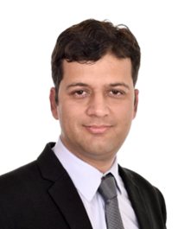
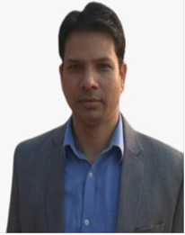
Together We Achieve more
Our team is full of passionate people who love to come to work.
CA NAVISH NAGPAL
(B.com, FCA, DISA, IFRS)
Mr. NAVISH Nagpal is known for his strong professional skills, ethics and communication skills. A person with extensive knowledge and expertise in the field of taxation, auditing and direct tax planning, He specializes in services related to income tax, internal audit, statutory audit, bank audit, management audit, preparation of tax returns, preparation of financial statements, corporate tax advisory, among others.
Joining the esteemed profession of Chartered Accountancy in the year 2005, he has developed expertise in direct tax planning, conducting reviews for efficient working of the company, maintenance of secretarial records, compliances under the Companies Act, development of overall financial reports for external users and preparation of financial forecasts for management and external auditing.
CA SANJAY KUMAR SINGH
(B.com, FCA)
Mr. SANJAY has been the visionary on whose vision the firm has evolved with the readiness to step into the new age of rendering professional services to the highest standards. Dynamic and energetic, with over 15 years of accounting and business experience. He assists clients with business and strategic planning, mergers & acquisitions, due diligence, internal controls and increasing operational efficiency. He has been responsible for numerous assignments in the tax and advisory services.
He has rich experience in banking audit i.e Statutory Audit, Concurrent Audit, Credit Audit, Valuation of Current Assets and due diligence work related to many banks like Canara Bank, Punjab National Bank, Etc. Currently he heads up the Indirect Tax and Management Consultancy activities of the firm.

Slide 6
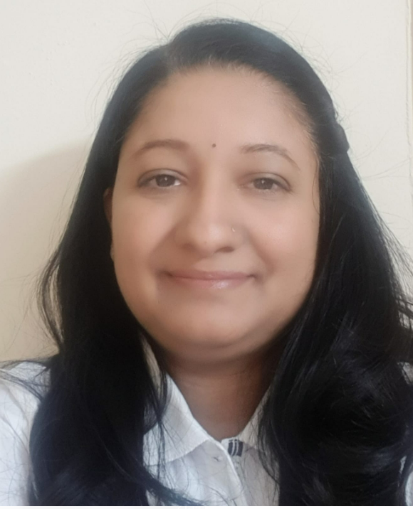
Together We Achieve more
Our team is full of passionate people who love to come to work. It is probably because work is not regarded as a duty. It is fun!
CA Shubham Mishra
(B.com, ACA )
Mrs. Shubham Mishra is one of the Managing Partners of the Firm. Known for her extensive knowledge and expertise in the field of Taxation, Auditing and Direct tax planning, She specializes in services related to Audit management Fixed Asset Management ,Preparation & Analysis of Financial statements.
She is a business professional with more than a decade and a half years of experience helping other businesses’s to grow and be more profitable. She has a strong and genuine passion for business growth and sustainability. She is a person with strong professional skills, ethics and communication skills
CA SURABHI GUPTA
(B.com, ACA)
Ms. Surabhi Gupta is one of the partners of the firm. She specializes in finalization of financial statements, cash flows, forecast of financial data and MIS. She have post qualification experience of about 4 years in the field of direct taxation as well as statutory and tax audits. She has worked with clients from manufacturing as well as trading sectors and has also carried statutory audit of various trusts. She focuses on utilizing firm resources in a way that results in providing best services to the clients.

Slide 7
NNCO -Service domain
Audit And Assurance Services
Process Outsourcing Services
Consultancy Services
Secretarial Services
The firm conducts various audits for Banks, Corporate and Non- corporate organizations.
Our Trained staff anticipate client needs, communicate clearly and take ownership of their work. We take every opportunity to help your business grow.
Audit Services Includes:
Statutory Audit
Internal Audit
Concurrent Audit
Stock Audit
Revenue Audit
Third Party Audit
Effective tax planning is integral to business strategy. We not only work with clients in formulating tax strategies, but also have the experience to help in its implementation effectively and speedily. We are focused on putting ideas to work for the clients.
The firm provides end-to-end Indirect Tax Services solutions including new registrations in GST, monthly/quarterly tax deposits and processing of monthly/quarterly returns, annual filing for the same.
Consultancy Services Includes:
Tax Planning and Structuring
Direct & Indirect Tax Compliance
Investment Planning
Indirect tax Refunds
GST Registration & Management
Trust/NGO Related Compliance & adherence
The Secretarial Compliance practice offers to our clients a full range of services, initiating from registering and getting the name approval of Co. to maintaining all compliance issues under the Companies Act, 2013
Services Includes:
Company Incorporation
Filing of e-returns with Registrar of Companies
Maintenance of Statutory records
Assistance in getting DIN, CIN etc.
Compliance of Company Law requirements
Corporate restructuring
Other legal requirements
Secretarial audits
Our process outsourcing services includes outsourcing services provided to big corporates like
Vendor and customer Support Services
Accounting support services
Transaction support
Services
Fixed Assets accounting and support services
Legal support services
SOP implementation and design and set up of accounting systems
MIS Reporting
HR and labour laws
compliances

Slide 8
NNCO -Service domain
Management Services
Due Diligence Reviews
Start-up Help
Accounting Outsourcing
This primarily includes Internal Audits which helps in production planning and control system of purchase forecasting, production scheduling, capacity usage, material management, inventory management controls, maintenance system and distribution logistics.
The internal audit exercise highlights the suggestion for improving efficiencies and effective management control.
Management Services Includes:
Internal Audit
Operational efficiency reviews
Special investigative audits
Costing and operating systems
Reporting on financial Statements
Arrangement of facilities i.e. Working Capital, Term loans, project finance etc.
Firm is involved in providing Due Diligence Reviews on Merger & Acquisitions of businesses.
This includes:
Conducting due diligences to generate valuable reports and business analysis
Helping businesses for their decision making and negotiation process
Conducting Financial due diligence involves analysis of the proposed deal by analyzing the financial statement and associated risks
Conducting Tax Due Diligence focusing corporate tax, social security and direct and indirect taxes due diligence while focusing on risks
Legal due diligence resulting in an assessment of the main risks and provide potential solutions that reduce the risk
Our firm is one stop solution for new start-ups. We add energies to motivated entrepreneurs during their initial set-up days and provide continuous support them for manifesting their ideas
The Partners of the firm has the knowledge and experience necessary to help such clients.
We are helping Start-ups in :
Company Registration
GST Registration
Brand Registration
ESI Registration
PF Registration
MSME Registration
DSC/DIN Registration
Bank Account
Running Companies Sale/Purchase
Virtual Office Space
Virtual CFO Services
In today’s scenario of globalization and technology convergence, the process of doing business has been redefined. Outsourcing various processes makes a lot of business sense. Most businesses and large companies are outsourcing their accounting processes for better management of their finance and time .
These services are structured to suit an individual client’s needs and requirements. Some of the accounts outsourcing services offered by us are as under:
Accounting
Bookkeeping
Individual and Business Tax Returns
Payroll Management
Yearend Finalization
Accounts Payable/Receivable
Reconciliation of Various Taxes

Slide 9
Audit And Assurance Services | Outsourcing | Tax | Regulatory
Indian GAAP / IND AS / Statutory audit | Statutory audit as per Indian GAAP; Transition from IGAAP to IND AS; Accounting of financial transactions and providing MIS.; Transaction and Process audit forming the part of risk advisory services.; Opinion on financial statements under Indian GAAP / IND AS; Issuing opinion / guidance on various accounting matters; Stock Audits / Fixed Assets Verification and Tagging.
IFRS | Audit under IFRS; Conversion of financial statements under IFRS/ US GAAP; Tax Accounting under US GAAP; Reconciliation from Indian GAAP to IFRS/ US GAAP; Opinion on accounting matters relating to IFRS/US GAAP;
Due Diligence | Individual; Company/Group; Inventory/Fixed Assets verification; Vendor screening & Integrity.
Forensic and investigation services | Fraud & Internal Investigations; Financial Investigations; Fraud Risk Mitigation; Anti-Bribery & Corruption; Regulatory Investigations.

Slide 10
Accounting / Assurance and Risk Advisory Services | Outsourcing | Tax | Regulatory
Vendor and Customer Management | Coordinating with vendors\Customers for certificate Coordination for vendor ledgers extraction and sending to Vendors and customers Vendor\Customers queries handling from time to time basis Periodic balances confirmation based on management policy and procedures Vendor and customers reconciliations and No dues certificates Vendor and customers reports extraction and other items
End to End accounting support | Transaction entry into accounting software; Bank account operations, reconciliation and funds monitoring; Process payments as per authorization matrix and SOPs.; Ensuring proper internal documentation along with the invoices; Inventory recording, management and valuation; Adhering to withholding tax laws and procedures; Preparation of various reports required by Management
Background checks | Ensure daily transactions such as additions, retirements, transfers, and modifications in ERP system by complying with established policies and standards like proper forms of assets acquisition and disposal etc. Dealing with Different departments like IT, Admin etc. for Acquisition\disposal and other requirements of relevant documentation etc. Perform reconciliation of fixed asset subsidiary ledger balance with summary-level account in the general ledgers Allocate tag numbers to fixed assets to effectively track them location and department wise. Perform depreciation calculation for all fixed Assets location wise. Preparation of Fixed Assets register complete in all requirements of invoices, Tag numbers, locations etc. Month end reporting of Fixed assets and closure as required by Management

Slide 11
Accounting / Assurance and Risk Advisory Services | Outsourcing | Tax | Regulatory
Business Tax Services | Identifying tax exposures and planning; Documentation, preparation and review of tax returns; Representation before Indian Statutory, fiscal authorities and competent authorities against proceedings under tax treaties; Domestic, Inbound and Outbound tax advisory; 15CA/CB certifications, Net worth certifications; Preparing the tax computations, deferred taxes and effective tax recon.
Indirect Tax Services | GST audits and reconciliation statements in 9 & 9C; Department Liaisoning and Assessments; All GST related compliances; GSTR 2A-2B recon, RCM applicability etc.
Transfer Pricing | Transfer Pricing Planning; Compliance and Documentation; Integrated tax planning; Transfer pricing audit services and representation before competent authority; Filing of Form 3CEB.

Slide 12
Accounting / Assurance and Risk Advisory Services | Outsourcing | Tax | Regulatory
RBI/ FEMA | Concurrent Audit as per RBI Guidelines; Assistance in filling of FLM 8 and various forms with RBI; Physical Verification of Forex cash in hand; Assistance in preparation and filing of returns/forms/information/documents with RBI; Assistance in obtaining RBI approval for making payment against restricted current account transactions; Assistance in obtaining approval from Foreign Investment Promotion Board; Advisory services under Foreign Investment Policy, telecom laws, land related laws; Assistance in obtaining other regulatory approvals, licenses, clarifications / dispensations; Obtaining prior approval/Registration to accept foreign contribution as required under Foreign Contribution (Regulation) Act. Filling and Filing of annual returns and other compliances on behalf of the Society / Trust accepting foreign contribution.
Company Law | Filing of requisite returns and forms with MCA; Maintenance of statutory registers under Companies Act, 2013; Preparing notices and agendas of the meetings, drafting resolutions and minutes; Drafting agreements with domestic/ foreign entities; Advisory on Company law matters; Compounding of offences committed under Companies Act, 2013; Extension for holding general body meeting after the permissible time frame; Approvals from Ministry of Corporate Affairs / Registrar of Companies.

Slide 13
Accounting / Assurance and Risk Advisory Services | Outsourcing | Tax | Regulatory
Advice on Legal Structure | Advising on legal structure (viz. Subsidiary, Joint Venture, Branch, Liaison Office, Project Office, etc.) for setting up of business in India.
Entity Formation/ India Entry services | Assisting in incorporation of companies/LLP/Section 25 companies/Liaison offices; Assisting in obtaining approval from RBI for Branch Office, Liaison Office and Project Office and their registration with Ministry of Corporate Affairs (MCA).
Tax and Regulatory Registrations | Assisting in obtaining Permanent Account Number (PAN), Tax Account Number (TAN) and TM/Copyright registration; Assisting in GST Registration Number and Tax Identification Numbers Assisting in obtaining registration under Shop and Establishment Act , Professional taxes, welfare funds and Provident Fund Scheme; Contract Risk Compliance.
Regulatory Aspects | Advising on regulatory issues related to investment in India and their resolution; Advising on the benefits and exemptions under SEZ scheme; Assisting in obtaining approvals from Foreign Investment Promotion Board (FIPB . Reserve Bank of India, SEZ and other authorities; Sarbanes-Oxley Compliance.

Slide 14
Our Clients
HealthCare Sector
Banking Sector
Trading and Services
Trusts and NGOs
Our team of experienced professionals provide financial solutions in a manner where client satisfaction is top priority.

Slide 15
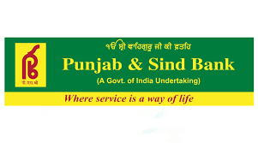
Our Clients
Banking Sector
GoldRush Capital Services Pvt. Ltd.

Slide 16
Our Clients
HealthCare Sector

Slide 17
Our Clients
Trading and Services

Slide 18
Our Clients
Trusts and NGOs

Slide 19
Contact Us
NAVISH NAGPAL & COMPANY
UNIT NO. 540, 5TH FLOOR, TOWER A2,
SPAZE I-TECH PARK,
SECTOR-49, SOHNA ROAD,
GURUGRAM -122018
HARYANA, INDIA
09582289938
09810232178
09711205178
NAVISH NAGPAL & COMPANY
HOUSE NO. 230,​
SECTOR 7, URBAN ESTATE,​
KARNAL -132001,​
HARYANA,​
INDIA​
E-Mail:
info@cannlco.com
Website:
http://www.navishnagpalandcompany.com/
NAVISH NAGPAL & COMPANY
At- SARDHO, PO- JINCHO,​
PS- SABOUR,​
DIST- BHAGALPUR,​
BIHAR -813210,​
INDIA
Linkedin:
www.linkedin.com/in/navish-nagpal-and-company-3592a31b4

